Slide 1
How Microwaves work

Slide 2
Outline
Parts of microwave
Interesting Property of microwaves
Role of Water

Slide 3
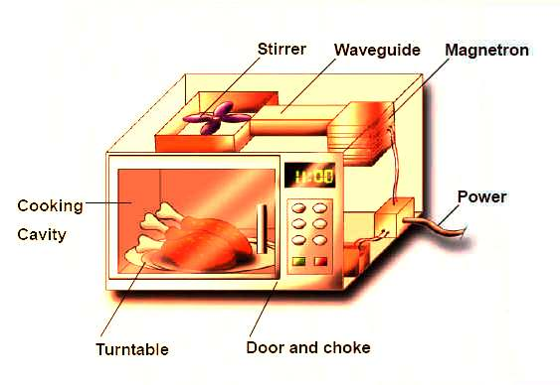
The machine
Cathode – emits electrons
Antenna – oscillates – 2.45 GHz
Source of ε
(Fischette, 2008)

Slide 4
The machine
Stirrer
Reflective walls
turntable
Even cooking
(Fischette, 2008)

Slide 5
Interesting!
Absorbed by H₂O
Microwave energy
NOT Absorbed by plastic, glass, ceramic

Slide 6
Interesting!
Absorbed by H₂O
Microwave energy
NOT Absorbed by plastic, glass, ceramic or metal
Atomic motion
Brain, (n.d.)

Slide 7
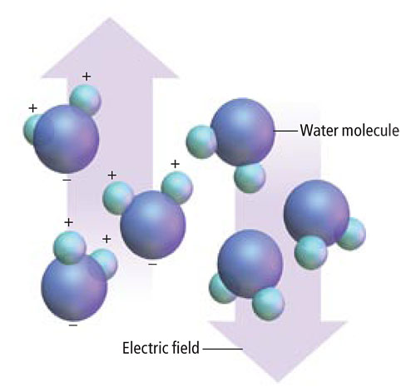
Water is Key
• Shifting ε rotates water.
• Torque
(Heimbecker et al, 2002)

Slide 8
Water is Key
• Rotation = atomic motion
= heat!
• polar bonds reforming = released heat
(Heimbecker et al, 2002)

Slide 9
Bibliography
Brain, M. (n.d.) How Microwave Cooking Works. Retrieved Dec. 10, 2013. http://home.howstuffworks.com/microwave1.htm
Fischetti, M. Oct. 3, 2008. How the Microwave Works. Retrieved Dec. 9, 2013. http://www.scientificamerican.com/slideshow.cfm?id=how-the-microwave-works
Heimbeck et al. (2002). Physics Concepts & Connection: part 2. Irwin Publishing, Toronto, ON.

